Slide 1




72
Vytvorenie systemu na kontrolu pritomnosti zamestnancov na jednotlivych stanoviskach Creation of a system for monitoring employee attendance at individual workstations
Team: Bc. Pavlo Usatiuk Bc. Jakub Almáši Mentor: Ing. Tomáš Girašek, PhD.

Slide 2




Problem
Current solutions rely on manual scanning or intrusive biometric and camera-based technologies.
Outdated technology
Manual scanning
Biometric leaking

Slide 3
For a small company... that's more than 8 working days per year
00:00:03:04
One employee loses about 1.25 working hours per year just by scanning an access card...

Slide 4
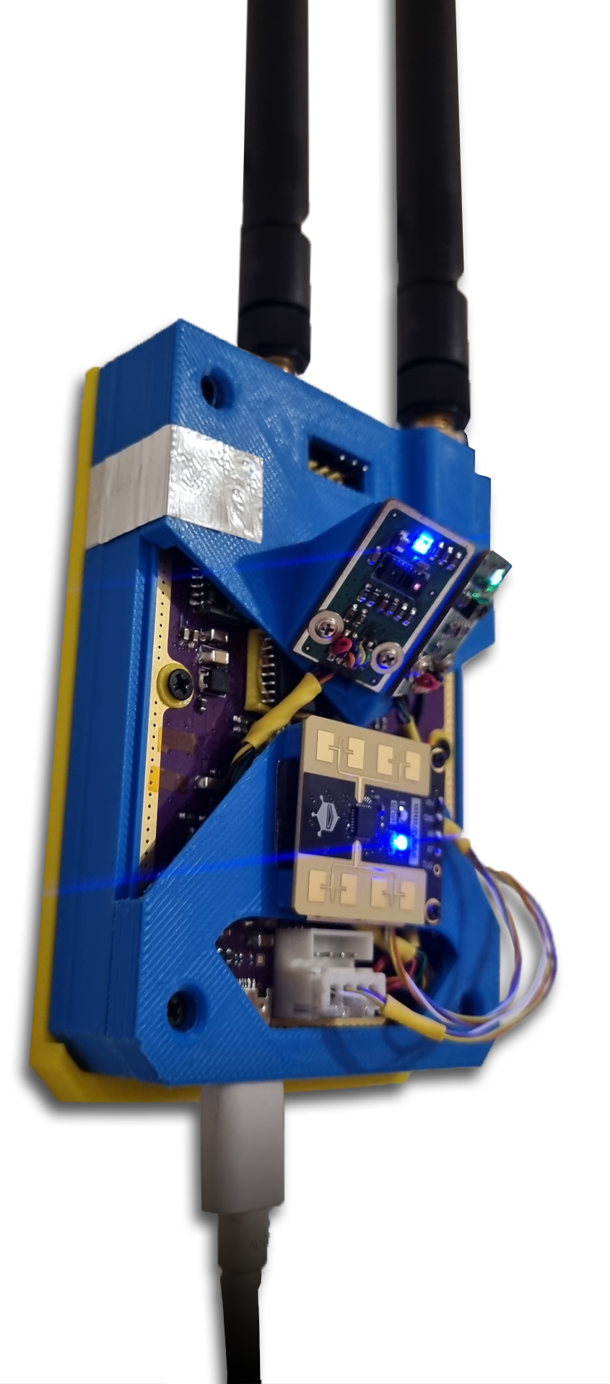



Solution
Multi-sensor embedded device for real-time presence and movement detection.
Legacy NFC Reader → UHF RFID
Camera-based system → ToF Sensors & Radar

Slide 5
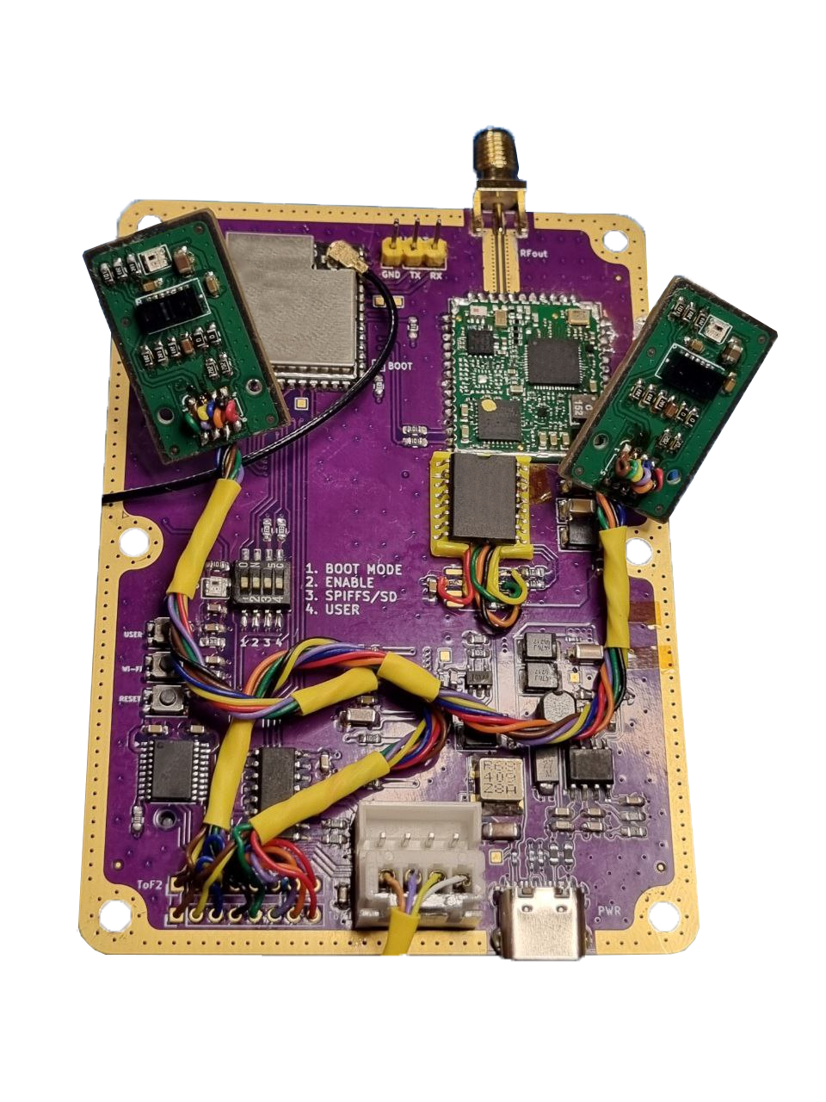
Solution
card reading up to 7 meters
direction detection up to 2 meters
motion/presence detection up to 25 meters
NO INTERACTION WITH THE DEVICE
98% ACCURACY (+80H OF TESTING)

Slide 6
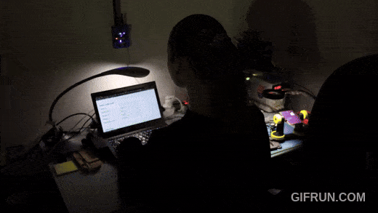
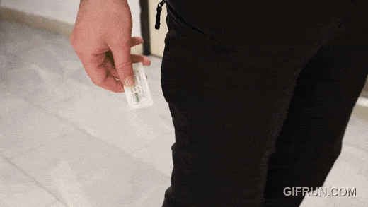
Demonstration

Slide 7

Thank you for attention
Sponsorship & support:

